Slide 1
Network and Cyber Security-I (CY2001) (Lecture 9 and 10)
Dr. Qaisar Shafi
Department of Computer Science,
National University of Computer & Emerging Sciences, Islamabad Campus

Slide 2
DATA ENCRYPTION STANDARD (DES)

Slide 3
DATA ENCRYPTION STANDARD
The Data Encryption Standard (DES) was designed by IBM.
DES , adopted in 1977 by National Bureau of Standards(NBS), now National institute of Standards and Technology(NIST) as Federal information processing standard 46.
It was unbroken for more than 10 years since its publication and some aspects of its design were kept secret by IBM at the request of the US National Security Agency (NSA); some people believed that IBM and NSA had hidden a trapdoor in DES that only they knew about (that they could use to crack DES)

Slide 4
DES -History
Under controversy, how secure the DES is?
In late 1960, IBM setup research in computer crypto led by Horst Fiestel.
Concluded in 1971, with LUCIFER(64-bit ,key 128-bit), use in cash-dispensing system.
Good results, decided to develop a marketable commercial encryption product that could implement on single chip.
Effort was headed by Walter Tuchman and Carl Meyer, with advice from NSA.
The outcome was a refined version of LUCIFER, more resistant to cryptanalysis, with reduced key of 56-bit, to fit on single chip.
In 1973, NBS, issue proposal for national chip standard , IBM submit project, and was adopted as DES in 1977.

Slide 5
DES-Criticism
Before adopting as standard ,intense criticism.
First, Enormous reduction in the key.
To short to withstand brude force attack.
Second , internal structure S-boxes was classified.

Slide 6
DES-wide use
DES flourish in financial applications.
In 1994, NIST reaffirm to use it for more 5 years.
In 1999, NIST issue a new version of its standard triple DES.

Slide 7
DES block cipher
Plaintext (64)
IP
Subkey 1 (48)
F
Subkey 2...15 (48)
F
Subkey 16 (48)
F
IP⁻¹
Ciphertext (64)

Slide 8
DES Encryption
There are two inputs to the encryption function: plaintext and key.
The plaintext must be 64 bit in length and the key is 56 bits in length*.
Left hand side of the figure, the processing of the plaintext is proceed in three phases.
First , the 64-bit plaintext passes through an initial permutation(IP) that rearrange the bits to produce permuted input.
This is followed by the phase of 16 rounds of the same function , involve substitution and permutation.
The output of the last(16th)round consists of 64-bits that are the function of input plaintext and the key.
The left and right halves of the output are swapped to produce the preoutput.
Finally , preoutput is passed through a permutation (IP⁻¹ ), to produce the 64-bit output.

Slide 9
DES Encryption(key)
The right-hand portion, shows how 56-bit key is used.
Initially , the key is passed through a permutation function.
For each of the 16 rounds, a subkey (k _{i}) is produced by the combination of the left circular shift and the permutation. the permutation function is same for each round, but the different subkey is produced because of the repeated shifts of the key bits.

Slide 10
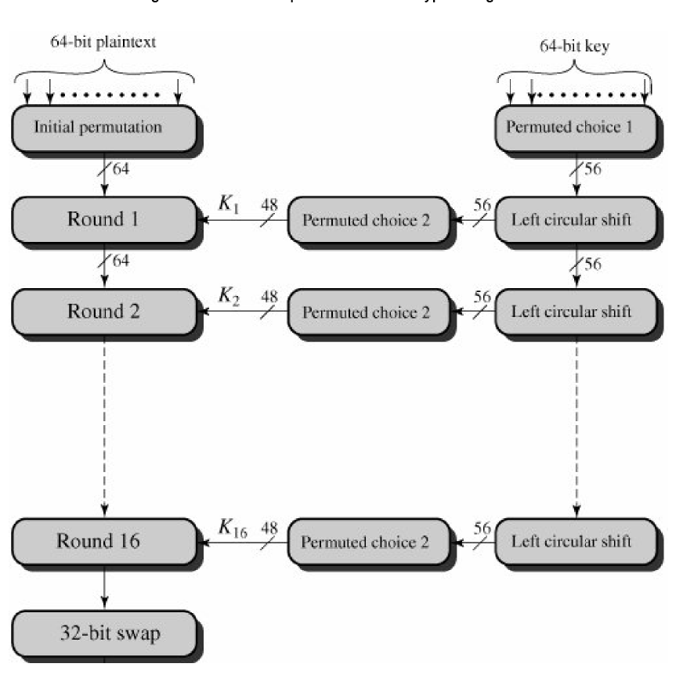
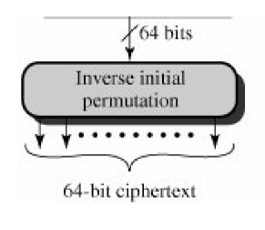

Slide 11
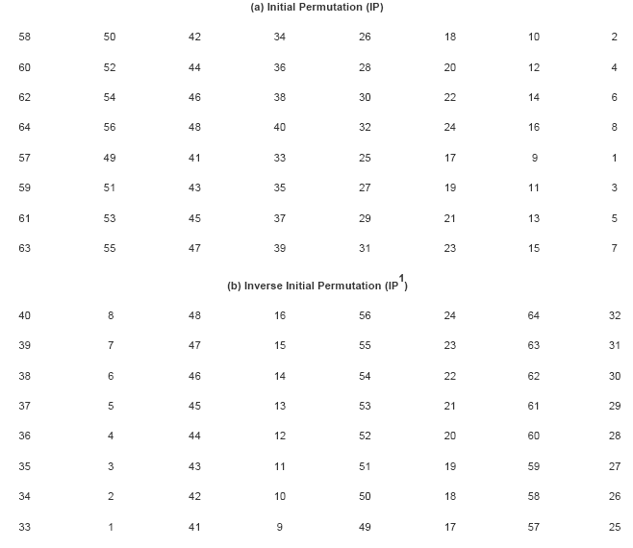

Slide 12
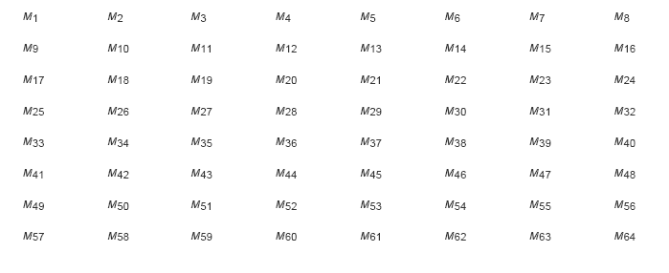
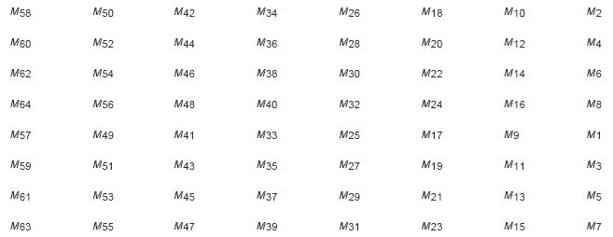

Slide 13
Initial Permutation: IP(from last tables)
The 32-bit input data (message) block is first bitwise permutated (i.e., the bits within the block are rearranged)
This is done using the following permutation table:
Output Input
1 2 3 4 5 6 7 8 58 50 42 34 26 18 10 2
9 10 11 12 13 14 15 16 60 52 44 36 28 20 12 4
17 18 19 20 21 22 23 24 62 54 46 38 30 22 14 6
25 26 27 28 29 30 31 32 64 56 48 40 32 24 16 8
33 34 35 36 37 38 39 40 57 49 41 33 25 17 9 1
41 42 43 44 45 46 47 48 59 51 43 35 27 19 11 3
49 50 51 52 53 54 55 56 61 53 45 37 29 21 13 5
57 58 59 60 61 62 63 64 63 55 47 39 31 23 15 7
Example: 35th bit of output block is equal to the 41st bit of the input block.
Notes:
Since bits are rearranged (their positions changed) and no bits are lost, this transformation (IP) is invertible.

Slide 14
Final Permutation: IP⁻¹
The 32-bit output after 16 rounds is finally bitwise permutated (i.e., the bits within the block are rearranged)
This is done using the following permutation table:
Output Input
1 2 3 4 5 6 7 8 40 8 48 16 56 24 64 32
9 10 11 12 13 14 15 16 39 7 47 15 55 23 63 31
17 18 19 20 21 22 23 24 38 6 46 14 54 22 62 30
25 26 27 28 29 30 31 32 37 5 45 13 53 21 61 29
33 34 35 36 37 38 39 40 36 4 44 12 52 20 60 28
41 42 43 44 45 46 47 48 35 3 43 11 51 19 59 27
49 50 51 52 53 54 55 56 34 2 42 10 50 18 58 26
57 58 59 60 61 62 63 64 33 1 41 9 49 17 57 25
Example: 41st bit of output block is equal to the 35th bit of the input block.

Slide 15
DES Cipher Function
Input (32)
Subkey (48)
32
E
F
48
48
48
S
32
Round
Function
P
32
Output (32)
Cipher
Function

Slide 16
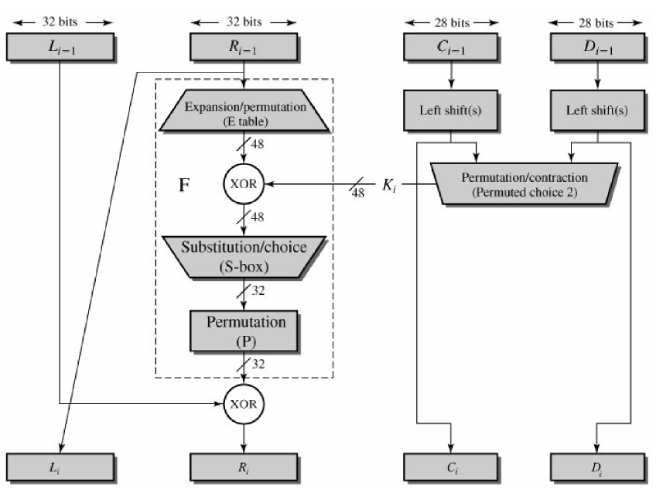
Detail of single Round(continue..)

Slide 17

The single round
The left hand side of the diagram, the left and right halves of each 64-bit are treated as 32-bit quantities labeled as L(left) and R(right).
The round key K_{i} is 48 bit. The R input is 32 bits.
The R input is first expanded to 48 bits by using table that involves duplication of 16 of the R bits.
The resulting 48 bits are XORed with k_{i}.
This 48-bit result passes through a substitution function that produces a 32-bit output , which is permuted

Slide 18
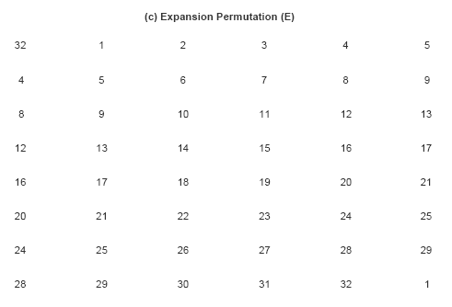

Slide 19
Expansion Permutation: E(from last table)
The expansion permutation acts on the 32-bit input to the cipher function
It expands the 32-bit input block to a 48-bit output block by duplicating some input bits at specified positions
The permutation is given by the following table:
Output bit Input bit
1 2 3 4 5 6 32 1 2 3 4 5
7 8 9 10 11 12 4 5 6 7 8 9
13 14 15 16 17 18 8 9 10 11 12 13
19 20 21 22 23 24 12 13 14 15 16 17
25 26 27 28 29 30 16 17 18 19 20 21
31 32 33 34 35 36 20 21 22 23 24 25
37 38 39 40 41 42 24 25 26 27 28 29
43 44 45 46 47 48 28 29 30 31 32 1
Example: 46nd bit of output block (counting from left, starting from bit 1) is equal to the 31st bit of input block

Slide 20
Expansion Permutation: E
32-bit data
48-bit expanded data

Slide 21
Substitution Boxes: S
The substitution boxes (S-boxes) map a 6-bit input block to a 4-bit output block
There are 8 S-boxes, so the 48-bit input block is mapped to a 32-bit output block

Slide 22
Substitution Boxes: S
S1
S2
S3
S4
S5
S6
S7
S8
Notes:
There are 8 S-boxes. Each S-box maps 6 bits to 4 bits.

Slide 23
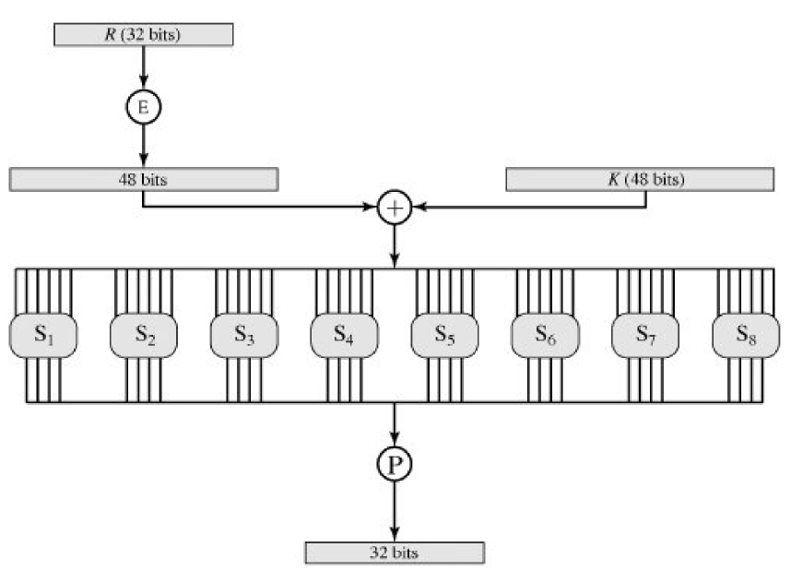

Slide 24
DES S-Boxes
S-Box S1
14 4 13 1 2 15 11 8 3 10 6 12 5 9 0 7
0 15 7 4 14 2 13 1 10 6 12 11 9 5 3 8
4 1 14 8 13 6 2 11 15 12 9 7 3 10 5 0
15 12 8 2 4 9 1 7 5 11 3 14 10 0 6 13
S-Box S2
15 1 8 14 6 11 3 4 9 7 2 13 12 0 5 10
3 13 4 7 15 2 8 14 12 0 1 10 6 9 11 5
0 14 7 11 10 4 13 1 5 8 12 6 9 3 2 15
13 8 10 1 3 15 4 2 11 6 7 12 0 5 14 9
S-Box S3
10 0 9 14 6 3 15 5 1 13 12 7 11 4 2 8
13 7 0 9 3 4 6 10 2 8 5 14 12 11 15 1
13 6 4 9 8 15 3 0 11 1 2 12 5 10 14 7
1 10 13 0 6 9 8 7 4 15 14 3 11 5 2 12
S-Box S4
7 13 14 3 0 6 9 10 1 2 8 5 11 12 4 15
13 8 11 5 6 15 0 3 4 7 2 12 1 10 14 9
10 6 9 0 12 11 7 13 15 1 3 14 5 2 8 4
3 15 0 6 10 1 13 8 9 4 5 11 12 7 2 14
Each S-box has 4 rows and
16 columns.
Suppose that the 6-bit input to
an S-box is denoted abcdef.
Let R = af (2 bit) and
let C = bcde (4 bit).
Look up the number at
row R and column C; this
number is the 4-bit output
of the S-box.

Slide 25
DES S-Boxes
S-Box S5
2 12 4 1 7 10 11 6 8 5 3 15 13 0 14 9
14 11 2 12 4 7 13 1 5 0 15 10 3 9 8 6
4 2 1 11 10 13 7 8 15 9 12 5 6 3 0 14
11 8 12 7 1 14 2 13 6 15 0 9 10 4 5 3
S-Box S6
12 1 10 15 9 2 6 8 0 13 3 4 14 7 5 11
10 15 4 2 7 12 9 5 6 1 13 14 0 11 3 8
9 14 15 5 2 8 12 3 7 0 4 10 1 13 11 6
4 3 2 12 9 5 15 10 11 14 1 7 6 0 8 13
S-Box S7
4 11 2 14 15 0 8 13 3 12 9 7 5 10 6 1
13 0 11 7 4 9 1 10 14 3 5 12 2 15 8 6
1 4 11 13 12 3 7 14 10 15 6 8 0 5 9 2
6 11 13 8 1 4 10 7 9 5 0 15 14 2 3 12
S-Box S8
13 2 8 4 6 15 11 1 10 9 3 14 5 0 12 7
1 15 13 8 10 3 7 4 12 5 6 11 0 14 9 2
7 11 4 1 9 12 14 2 0 6 10 13 15 3 5 8
2 1 14 7 4 10 8 13 15 12 9 0 3 5 6 11
Example: Input 101011 to
S-box 5 corresponds to row
11 = 3 -> 4th and column 0101
= 5 -> 6th column; output is 14
= 1110

Slide 26
Permutation: P
The 32-bit output of the S-boxes is then bitwise permutated (i.e., the bits within the block are rearranged)
This is done using the following permutation table:
Output Input
1 2 3 4 16 7 20 21
5 6 7 8 29 12 28 17
9 10 11 12 1 15 23 26
13 14 15 16 5 18 31 10
17 18 19 20 2 8 24 14
21 22 23 24 32 27 3 9
25 26 27 28 19 13 30 6
29 30 31 32 22 11 4 25
Example: 25th bit of output block is equal to the 19th bit of the input block.

Slide 27
DES Key Schedule
The DES key schedule takes a 64-bit key and generates 16 48-bit subkeys, one per round
The key schedule uses two (fixed/known) permutation tables (called PC1 and PC2) and a table of “shifts” (called LS)

Slide 28
DES key Schedule
The 64-bit key is used as input to the algorithm.
The key is first subjected to a permutation governed by the table labeled permuted choice one.
The resulting 56-bit key is then treated as two 28-bit quantities, labeled C₀ and D₀.
At each round, C_{i-1} and D_{i-1} are separately subjected to circular left shift or rotation , of 1 to 2 bits, these values serve as input to the next round.
They also serve as input to permutation Choice Two, which produce 48-bit ouput that serve as input to the function F(R_{i-1},K_{i}).

Slide 29
DES Key Schedule
Key (64)
PC1
Effective Key (56)
Round number = 1
Round
number
LS
LS
Round
number
Is Round number = 16?
Yes
End
PC2
No
Increment round number
Subkey (48)

Slide 30
Permuted Choice 1: PC1
The permutation PC1 takes the 64-bit key and produces a 56-bit key by discarding every 8th bit in the key
This means that the effective key size of DES is not 64 bits, but 56 bits (since the 8 bits that are discarded have no effect on the encryption or decryption of data)
The 56-bit effective key is then processed to produce the 16 48-bit round keys (subkeys)

Slide 31
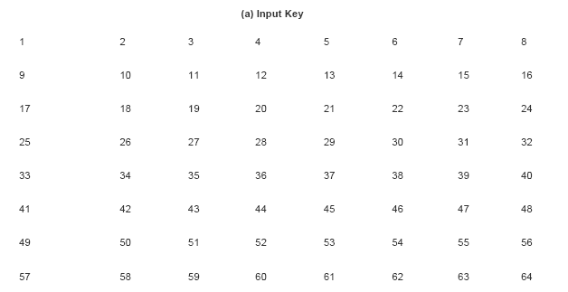
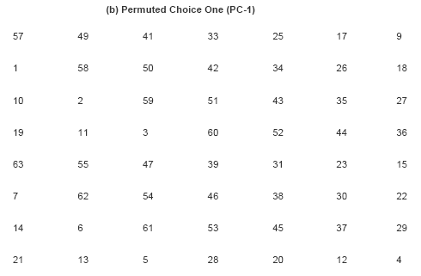

Slide 32
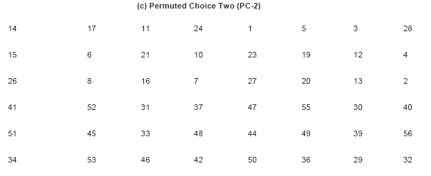
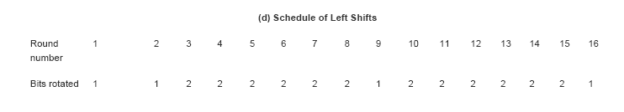

Slide 33
Permuted Choice 1: PC1(from last Tables)
The PC1 permutation is described by the following table:
Effective Key Bit Input Key Bit
1 2 3 4 5 6 7 57 49 41 33 25 17 9
8 9 10 11 12 13 14 1 58 50 42 34 26 18
15 16 17 18 19 20 21 10 2 59 51 43 35 27
22 23 24 25 26 27 28 19 11 3 60 52 44 36
29 30 31 32 33 34 35 63 55 47 39 31 23 15
36 37 38 39 40 41 42 7 62 54 46 38 30 22
43 44 45 46 47 48 49 14 6 61 53 45 37 29 50 51 52 53 54 55 56 21 13 5 28 20 12 4
Example: The 9th bit of the 56-bit effective key is the 58th bit of the original 64-bit key

Slide 34
Iterated Left Shift: LS
The 56-bit output to PC1 is then input to a loop that is iterated 16 times
Each iteration of this loop generates a 48-bit subkey
Depending on the iteration, the 56-bit key is bitwise rotated to the left a fixed number of times according to the following table:
Iteration 1 2 3 4 5 6 7 8 9 10 11 12 13 14 15 16
Left Shifts 1 1 2 2 2 2 2 2 1 2 2 2 2 2 2 1
Note that the shifts are cumulative: i.e., in the third iteration, the 56-bit key is rotated 4 bits to the left compared to the original 56-bit input

Slide 35
Permuted Choice 2: PC2
After being bitwise rotated (shifted), the 56-bit key is input to a permutation function that selects 48 bits from the key to produce the round key (subkey)
This table, called PC2, is described as follows:
Subkey Bit Input Bit
1 2 3 4 5 6 14 17 11 24 1 5
7 8 9 10 11 12 3 28 15 6 21 10
13 14 15 16 17 18 23 19 12 4 26 8
19 20 21 22 23 24 16 7 27 20 13 2
25 26 27 28 29 30 41 52 31 37 47 55
31 32 33 34 35 36 30 40 51 45 33 48
37 38 39 40 41 42 44 49 39 56 34 53
43 44 45 46 47 48 46 42 50 36 29 32
Example: The 30th bit of the 48-bit subkey is the 55th bit of the 56-bit input

Slide 36
DES Decryption
The decryption uses the same algorithm as encryption , except the application of subkeys are reversed.

Slide 37
The Avalanche Effect
The property of encryption algorithm is that , a small change in either the plaintext or the key should produce a significant change in the cipher text.
In particular , a change in one bit of the plaintext or one bit of the key should produce a change in many bits of the cipher text.

Slide 38

DES Avalanche Effect
DES exhibits a strong avalanche effect.
In table, two plaintext that differ by one bit were used.
With the key

Slide 39

DES Avalanche Effect
Table b, shows a similar test in which a single plaintext is input:
With two keys that differ in only one bit position

Slide 40
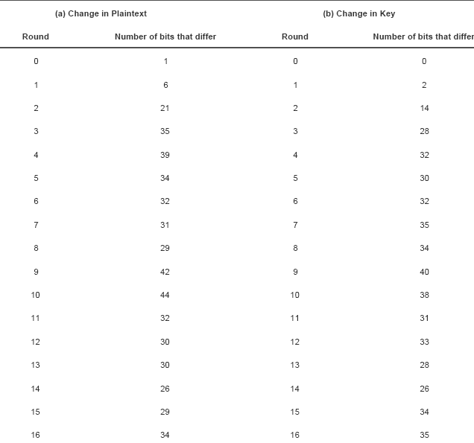

Slide 41
The Strength of DES
The key length is 56 bits, there are 2⁵⁶ possible keys, 7.2 X 10 ¹⁶ keys, brute force attack impractical.
Assuming, on average half the key space has to be searched , a single machine performing on DES encryption per microsec would take more than 1000 years to break the cipher.
In 1977, Deffie Hallman, postulated that the technology existed to build a parallel machine with 1 million encryption devices, each of which could perform one encryption per microsec.
This would bring search time to about 10 hours , cost $20 million.

Slide 42
DES Strength
DES finally proved insecure in July 1998,
When the Electronic Frontier Foundation(EFF) declared broken DES using “DES cracker”, cost $250,000 and publish the description of cracker , enables others to build their own, with decrease price of hardware and increase speed make DES worthless.

Slide 43
END OF LECTURE

Slide 44
Any Questions ?

